Slide 1
CST 205 OOP :Core Java Fundamentals

Slide 2
SYLLABUS
Primitive Data types - Integers, Floating Point Types, Characters, Boolean. Literals, Type Conversion and Casting, Variables, Arrays, Strings, Vector class.
Operators - Arithmetic Operators, Bitwise Operators, Relational Operators, Boolean Logical Operators, Assignment Operator, Conditional (Ternary) Operator, Operator Precedence.
Control Statements - Selection Statements, Iteration Statements and Jump Statements
Object Oriented Programming in Java - Class Fundamentals, Declaring Objects, Object Reference, Introduction to Methods, Constructors, this Keyword, Method Overloading, Using Objects as Parameters, Returning Objects, Recursion, Access Control, Static Members, Final Variables, Inner Classes, Command Line Arguments, Variable Length Arguments.
Inheritance - Super Class, Sub Class, The Keyword super, protected Members, Calling Order of Constructors, Method Overriding, the Object class, Abstract Classes and Methods, using final with Inheritance.

Slide 3
OBJECTIVES
Class Fundamentals
Declaring Objects
Object Reference
Introduction to Methods
Constructors
this Keyword
finalize method
CO2 : Develop Java application programs using java constructs, operators, control statements, built in packages and libraries.

Slide 4
Class Fundamentals
A class is a template for an object, and an object is an instance of a class.
The General Form of a Class
class classname { type instance-variable1; type instance-variable2; …………………… ……………………. type instance-variableN; type methodname1(parameter-list) { // body of method } | type methodname2(parameter-list) { // body of method } // ... type methodnameN(parameter-list) { // body of method } }

Slide 5
Class Fundamentals
The data, or variables, defined within a class are called instance variables. The code is contained within methods.
Collectively, the methods and variables defined within a class are called members of the class.
In most classes, the instance variables are acted upon and accessed by the methods defined for that class. Thus, as a general rule, it is the methods that determine how a class’ data can be used.
Variables defined within a class are called instance variables because each instance of the class (that is, each object of the class) contains its own copy of these variables.
Thus, the data for one object is separate and unique from the data for another.

Slide 6
A Simple Class
class Box {
double width;
double height;
double depth;
}
To actually create a Box object, you will use a statement like the following:
Box mybox = new Box(); // create a Box object called mybox
After this statement executes, mybox will be an instance of Box .
Every Box object will contain its own copies of the instance variables width, height, and depth.
To access these variables, you will use the dot (.) operator.

Slide 7
A Simple Class
/* A program that uses the Box class.
Call this file BoxDemo.java
*/
class Box {
double width;
double height;
double depth;
}
// This class declares an object of type Box.
class BoxDemo {
public static void main(String args[]) {
Box mybox = new Box();
double vol;

Slide 8
A Simple Class
// assign values to mybox's instance variables
mybox.width = 10;
mybox.height = 20;
mybox.depth = 15;
// compute volume of box
vol = mybox.width * mybox.height * mybox.depth;
System.out.println("Volume is " + vol);
}
}

Slide 9
A Simple Class
You should call the file that contains this program BoxDemo.java, because the main( ) method is in the class called BoxDemo, not the class called Box.
When you compile this program, you will find that two .class files have been created, one for Box and one for BoxDemo.
The Java compiler automatically puts each class into its own .class file.
It is not necessary for both the Box and the BoxDemo class to actually be in the same source file.
You could put each class in its own file, called Box.java and BoxDemo.java, respectively.
To run this program, you must execute BoxDemo.class.
When you do, you will see the following output:
Volume is 3000.0

Slide 10
A Simple Class
// This program declares two Box objects.
class Box {
double width;double height;double depth;
}
class BoxDemo2 {
public static void main(String args[]) {
Box mybox1 = new Box();
Box mybox2 = new Box();
double vol;
// assign values to mybox1's instance variables
mybox1.width = 10;
mybox1.height = 20;
mybox1.depth = 15;

Slide 11
A Simple Class
/* assign different values to mybox2's instance variables */
mybox2.width = 3;
mybox2.height = 6;
mybox2.depth = 9;
// compute volume of first box
vol = mybox1.width * mybox1.height * mybox1.depth;
System.out.println("Volume is " + vol);
// compute volume of second box
vol = mybox2.width * mybox2.height * mybox2.depth;
System.out.println("Volume is " + vol);
}}
The output produced by this program is shown here:
Volume is 3000.0
Volume is 162.0

Slide 12
Declaring Objects
Obtaining objects of a class is a two-step process.
First, you must declare a variable of the class type. This variable does not define an object.Instead, it is simply a variable that can refer to an object.
Second, you must acquire an actual, physical copy of the object and assign it to that variable. You can do this using the new operator.
The new operator dynamically allocates (that is, allocates at run time) memory for an object and returns a reference to it.
This reference is, more or less, the address in memory of the object allocated by new.
This reference is then stored in the variable.
Thus, in Java, all class objects must be dynamically allocated.

Slide 13
Declaring Objects
Box mybox = new Box();
This statement combines the two steps. It can be rewritten like this to show each step more clearly:
Box mybox; // declare reference to object
mybox = new Box(); // allocate a Box object
The first line declares mybox as a reference to an object of type Box.
After this line executes, mybox contains the value null, which indicates that it does not yet point to an actual object.
The next line allocates an actual object and assigns a reference to it to mybox.
After the second line executes,you can use mybox as if it were a Box object.
But in reality, mybox simply holds the memory address of the actual Box object.

Slide 14
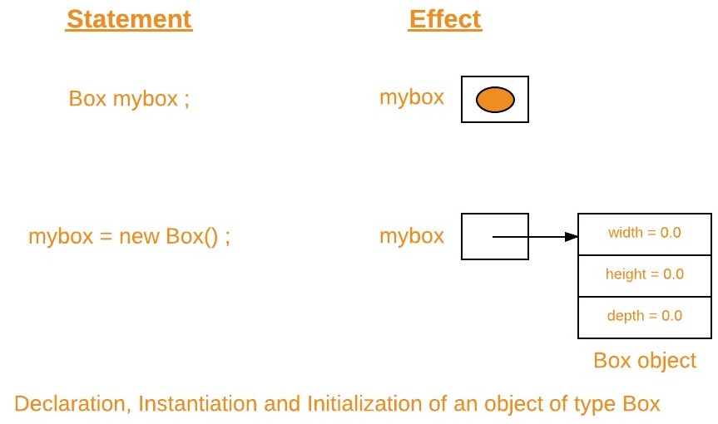
Declaring Objects

Slide 15
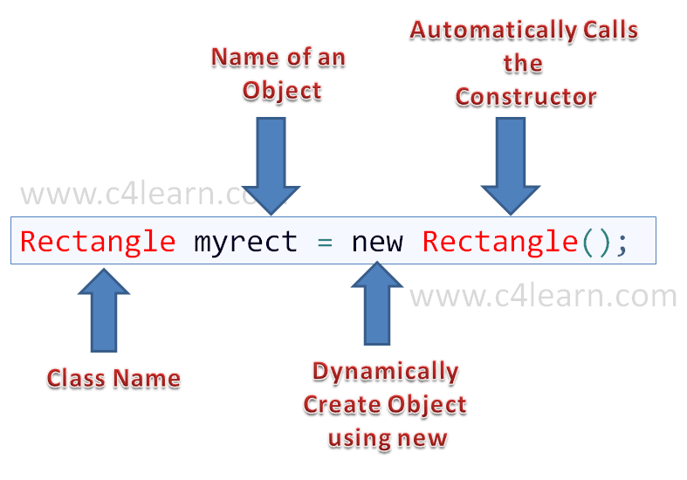
Declaring Objects

Slide 16
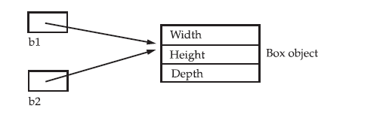
Assigning Object Reference Variables
Box b1 = new Box();
Box b2 = b1;
After this fragment executes, b1 and b2 will both refer to the same object.
The assignment of b1 to b2 did not allocate any memory or copy any part of the
original object.
It simply makes b2 refer to the same object as does b1.
Thus, any changes made to the object through b2 will affect the object to which b1 is referring, since they are the same object.

Slide 17
Introducing Methods
This is the general form of a method:
type name(parameter-list) {
// body of method
}
Here, type specifies the type of data returned by the method.
The method does not return a value, its return type must be void.
The parameter-list is a sequence of type and identifier pairs separated by commas. Parameters are essentially variables that receive the value of the arguments passed to the method when it is called.
Methods that have a return type other than void return a value to the calling routine using the following form of the return statement:
return value;

Slide 18
Adding a Method to the Box Class
class Box { double width; double height; double depth; // display volume of a box void volume() { System.out.print("Volume is "); | System.out.println(width * height * depth); } } class BoxDemo3 { public static void main(String args[]) { Box mybox1 = new Box(); Box mybox2 = new Box();

Slide 19
Adding a Method to the Box Class
// assign values to mybox1's instance variables mybox1.width = 10; mybox1.height = 20; mybox1.depth = 15; /* assign different values to mybox2's instance variables */ mybox2.width = 3; mybox2.height = 6; mybox2.depth = 9; | // display volume of first box mybox1.volume(); // display volume of second box mybox2.volume(); } } OUTPUT – Volume is 3000.0 Volume is 162.0

Slide 20
Adding a Method to the Box Class
The first line here invokes the volume( ) method on mybox1.
That is, it calls volume( ) relative to the mybox1 object, using the object’s name followed by the dot operator.
When mybox1.volume( ) is executed, the Java run-time system transfers control to the code defined inside volume( ).
After the statements inside volume( ) have executed, control is returned to the calling routine, and execution resumes with the line of code following the call.
When an instance variable is accessed by code that is not part of the class in which that instance variable is defined, it must be done through an object, by use of the dot operator.

Slide 21
Returning a Value
class Box { double width; double height; double depth; // compute and return volume double volume() { return width * height * depth; }} class BoxDemo4 { public static void main(String args[]) { Box mybox1 = new Box(); Box mybox2 = new Box(); double vol; | mybox1.width = 10; mybox1.height = 20; mybox1.depth = 15; /* assign different values to mybox2's instance variables */ mybox2.width = 3; mybox2.height = 6; mybox2.depth = 9; // get volume of first box vol = mybox1.volume(); System.out.println("Volume is " + vol); vol = mybox2.volume(); System.out.println("Volume is " + vol); } }

Slide 22
Returning a Value
There are two important things to understand about returning values:
The type of data returned by a method must be compatible with the return type specified by the method.
For example, if the return type of some method is boolean,you could not return an integer.
The variable receiving the value returned by a method (such as vol, in this case) must also be compatible with the return type specified for the method.
One more point: The preceding program can be written a bit more efficiently because there is actually no need for the vol variable.
System.out.println("Volume is " + mybox1.volume());

Slide 23
Adding a Method That Takes Parameters
Parameters allow a method to be generalized. That is, a parameterized method can operate on a variety of data and/or be used in a number of slightly different situations.
int square()
{
return 10 * 10;
}
If you modify the method so that it takes a parameter, as shown next, then you can make square( ) much more useful.
int square(int i)
{
return i * i;
}

Slide 24
Adding a Method That Takes Parameters
Parameter vs Argument
A parameter is a variable defined by a method that receives a value when the method is called.
For example, in square( ), i is a parameter.
An argument is a value that is passed to a method when it is invoked.
For example, square(100) passes 100 as an argument. Inside square( ), the parameter i receives that value.

Slide 25
Parameterized method to improve the Box class
class Box {
double width;
double height;
double depth;
double volume() {
return width * height * depth;
}
// sets dimensions of box
void setDim(double w, double h, double d) {
width = w;
height = h;
depth = d;
}}

Slide 26
Parameterized method to improve the Box class
class BoxDemo5 { public static void main(String args[]) { Box mybox1 = new Box(); Box mybox2 = new Box(); double vol; // initialize each box mybox1.setDim(10, 20, 15); mybox2.setDim(3, 6, 9); | // get volume of first box vol = mybox1.volume(); System.out.println("Volume is " + vol); // get volume of second box vol = mybox2.volume(); System.out.println("Volume is " + vol); } }

Slide 27
Constructors
A constructor initializes an object immediately upon creation.
It has the same name as the class in which it resides and is syntactically similar to a method.
Once defined, the constructor is automatically called immediately after the object is created, before the new operator completes.
Constructors have no return type, not even void. This is because the implicit return type of a class’ constructor is the class type itself.
It is the constructor’s job to initialize the internal state of an object so that the code creating an instance will have a fully initialized, usable object immediately.

Slide 28
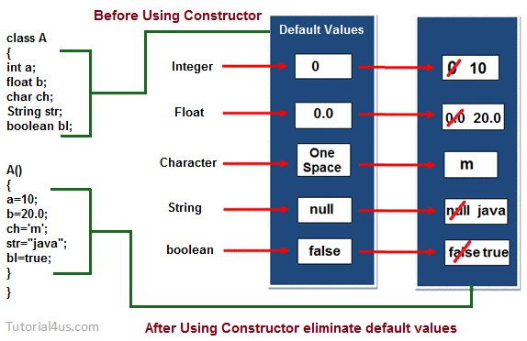

Slide 29
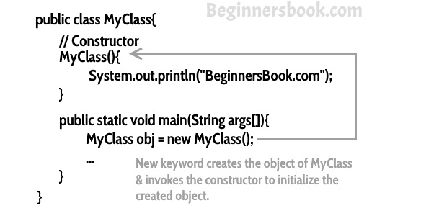
Constructors

Slide 30
Constructors
public class Hello
{
String name;
Hello() //Constructor
{
name = "BeginnersBook.com";
}
public static void main(String[] args)
{
Hello obj = new Hello();
System.out.println(obj.name);
} }

Slide 31
Constructors
class Box { double width; double height; double depth; // This is the constructor for Box. Box() { System.out.println("Constructing Box"); width = 10; height = 10; depth = 10; } | // compute and return volume double volume() { return width * height * depth; } } class BoxDemo6 { public static void main(String args[]) { // declare, allocate, and initialize Box objects Box mybox1 = new Box(); Box mybox2 = new Box(); double vol;

Slide 32
Constructors
// get volume of first box vol = mybox1.volume(); System.out.println("Volume is " + vol); // get volume of second box vol = mybox2.volume(); System.out.println("Volume is " + vol); } } | OUTPUT Constructing Box Constructing Box Volume is 1000.0 Volume is 1000.0

Slide 33
Constructors
Box mybox1 = new Box();
new Box( ) is calling the Box( ) constructor.
When you do not explicitly define a constructor for a class, then Java creates a default constructor for the class.
This is why the preceding line of code worked in earlier versions of Box that did not define a constructor.
The default constructor automatically initializes all instance variables to zero.
The default constructor is often sufficient for simple classes, but it usually won’t do for more sophisticated ones.
Once you define your own constructor, the default constructor is no longer used.

Slide 34
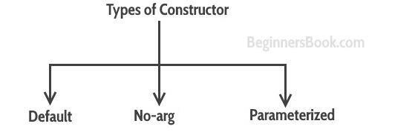
Constructors

Slide 35
Java Constructor with no parameters [No arg constructor]
Syntax of constructor:
<classname>(){}
//Java Program to create a constructor
class Bike1{
Bike1() {
System.out.println("Bike is created");
}
public static void main(String args[]){
Bike1 b=new Bike1(); //calling constructor
} }

Slide 36
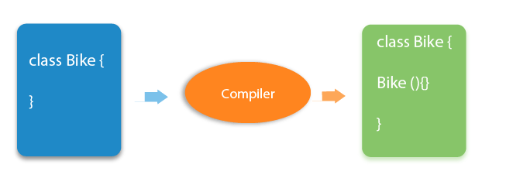
Constructor
Java Default Constructor
If there is no constructor in a class, compiler automatically creates a default constructor. The default constructor is used to provide the default values to the object like 0, null, etc., depending on the type.
Parameterized Constructor
A constructor which has a specific number of parameters is called a parameterized constructor.
The parameterized constructor is used to provide different values to distinct objects.

Slide 37
Parameterized Constructors
class Box { double width; double height; double depth; // This is the constructor for Box. Box(double w, double h, double d) { width = w; height = h; depth = d; } // compute and return volume double volume() { return width * height * depth;} } | class BoxDemo7 { public static void main(String args[]) { // declare, allocate, and initialize Box objects Box mybox1 = new Box(10, 20, 15); Box mybox2 = new Box(3, 6, 9); double vol; // get volume of first box vol = mybox1.volume(); System.out.println("Volume is " + vol); // get volume of second box vol = mybox2.volume(); System.out.println("Volume is " + vol); }}

Slide 38
Parameterized Constructors
The output from this program is shown here:
Volume is 3000.0
Volume is 162.0
As you can see, each object is initialized as specified in the parameters to its constructor.
For example, in the following line,
Box mybox1 = new Box(10, 20, 15);
The values 10, 20, and 15 are passed to the Box( ) constructor when new creates the object.
Thus, mybox1’s copy of width, height, and depth will contain the values 10, 20, and 15,respectively.

Slide 39
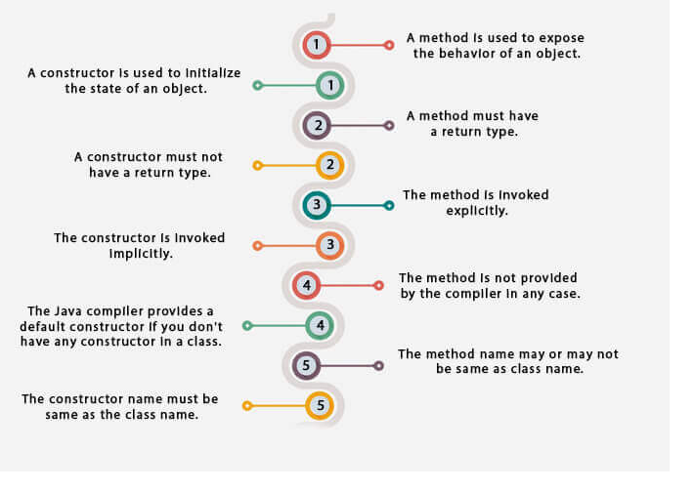
Method vs Constructor

Slide 40
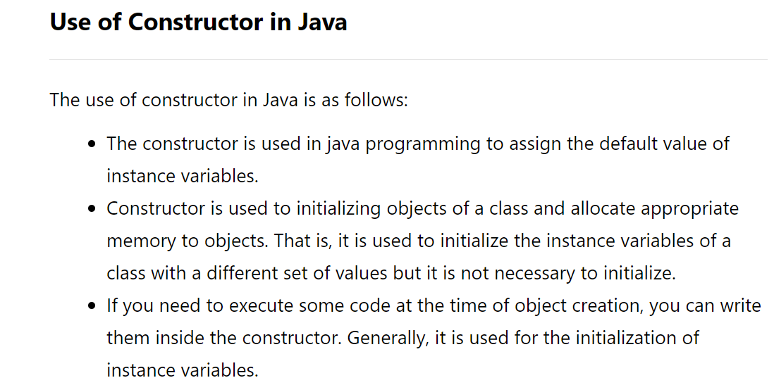

Slide 41
The this Keyword
Sometimes a method will need to refer to the object that invoked it.
To allow this, Java defines the this keyword.
this can be used inside any method to refer to the current object.
That is,this is always a reference to the object on which the method was invoked.
// A redundant use of this.
Box(double w, double h, double d)
{
this.width = w;
this.height = h;
this.depth = d;
}
Inside Box( ), this will always refer to the invoking object. The use of this is redundant,but perfectly correct.

Slide 42
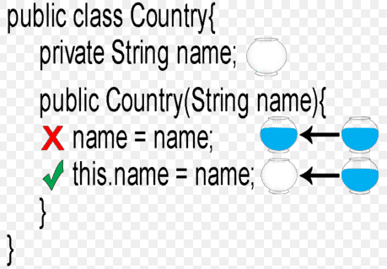
Use of this Keyword -Instance Variable Hiding

Slide 43
Use of this Keyword -Instance Variable Hiding
You can have local variables, including formal parameters to methods, which overlap with the names of the class’ instance variables.
This is why width, height, and depth were not used as the names of the parameters to the Box( ) constructor inside the Box class.
If they had been, then width would have referred to the formal parameter, hiding the instance variable width.
Because this lets you refer directly to the object, you can use it to resolve any name space collisions that might occur between instance variables and local variables.
// Use this to resolve name-space collisions.
Box(double width, double height, double depth) {
this.width = width;
this.height = height;
this.depth = depth;
}

Slide 44
Garbage Collection -The finalize( ) Method
When no references to an object exist, that object is assumed to be no longer needed, and the memory occupied by the object can be reclaimed. Java handles deallocation for you automatically.
Sometimes an object will need to perform some action when it is destroyed.
For example, if an object is holding some non-Java resource such as a file handle or character font, then you might want to make sure these resources are freed before an object is destroyed.
To handle such situations, Java provides a mechanism called finalization. By using finalization, you can define specific actions that will occur when an object is just about to be reclaimed by the garbage collector.
To add a finalizer to a class, you simply define the finalize( ) method.

Slide 45
Garbage Collection -The finalize( ) Method
The Java run time calls that method whenever it is about to recycle an object of that class. Inside the finalize( ) method, you will specify those actions that must be performed before an object is destroyed.
The garbage collector runs periodically, checking for objects that are no longer referenced by any running state or indirectly through other referenced objects.
The finalize( ) method has this general form:
protected void finalize( )
{
// finalization code here
}
Here, the keyword protected is a specifier that prevents access to finalize( ) by code defined outside its class.
finalize( ) is only called just prior to garbage collection.

Slide 46
SUMMARY
The data, or variables, defined within a class are called instance variables. The code is contained within methods.
Obtaining objects of a class is a two-step process.
First, you must declare a variable of the class type. This variable does not define an object.Instead, it is simply a variable that can refer to an object.
Second, you must acquire an actual,physical copy of the object and assign it to that variable. You can do this using the new operator.
A constructor initializes an object immediately upon creation.

Slide 47
Thanks!
Any questions?

